Slide 1
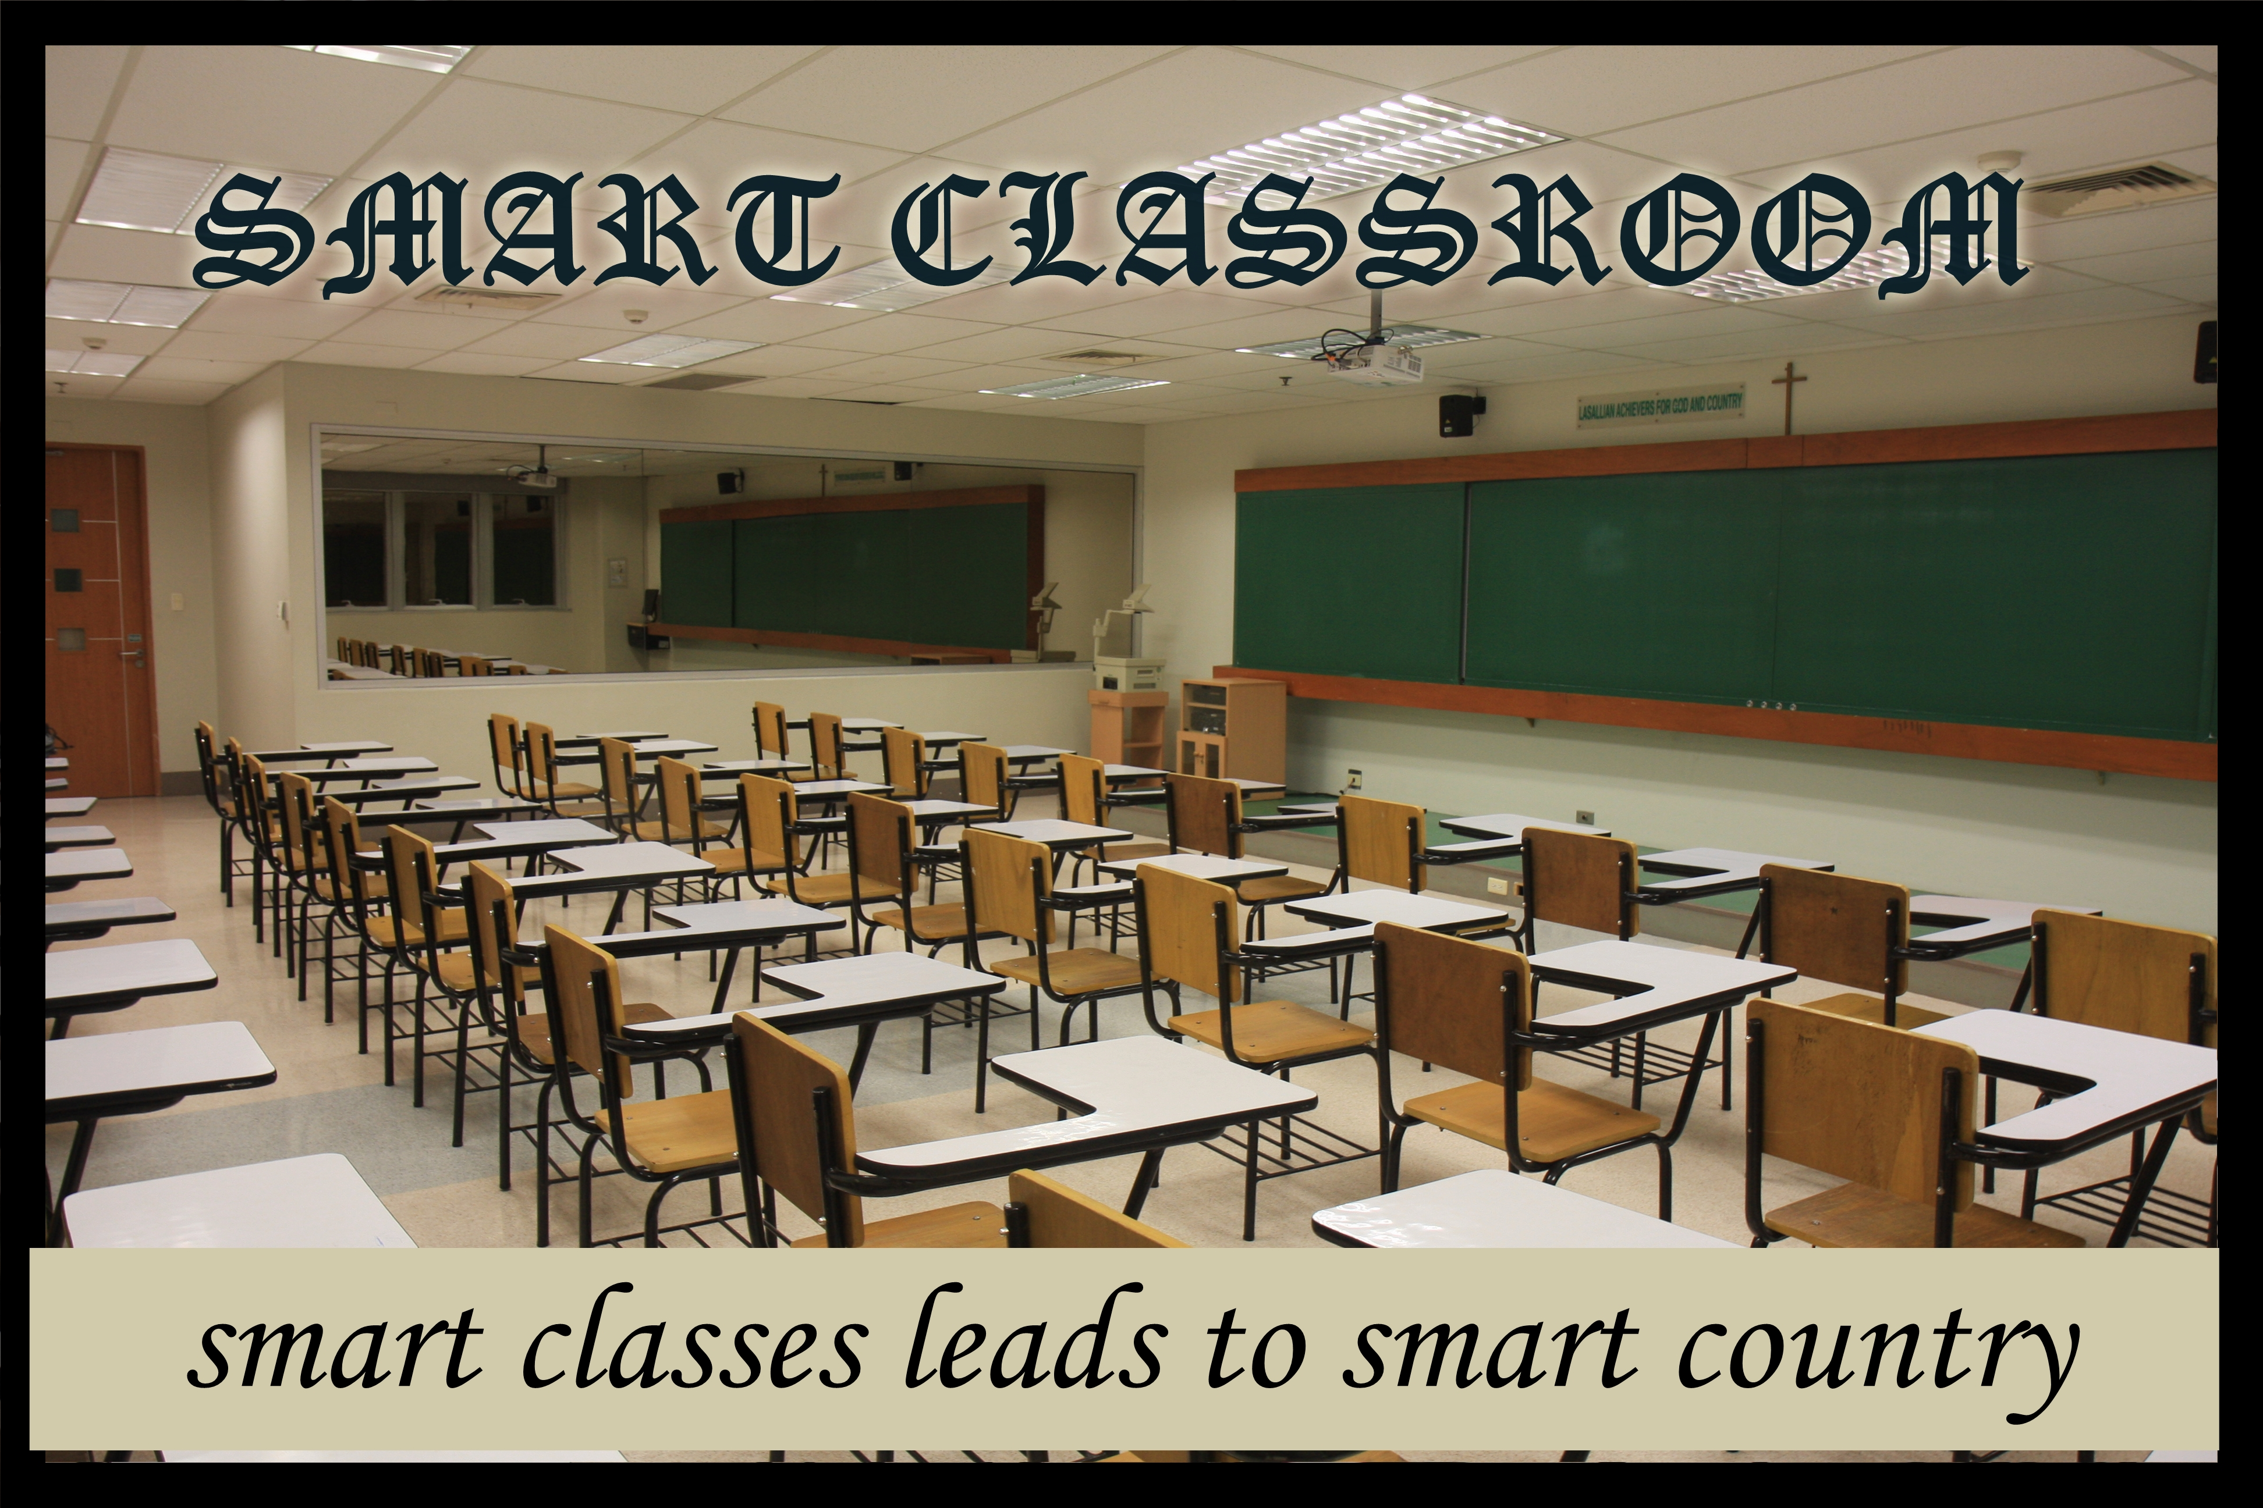

Slide 2
PROBLEM 1
In 2018, we are still switching on and off the lights, fan, air conditioner manually in a classroom. Most of the time students enter and leaves the room without turning off the devices, which significantly leads to a huge wastage of electricity.

Slide 3
PROBLEM 2
People have a habit of switching ON all the switches at a public place, even if his desired interest is confined.

Slide 4
APPROACH TOWARDS THE SOLUTION
There are two methods by which we can significantly cut down the power losses in a class room:-
.

Slide 5
APPROACH 1
By deploying a person at every classroom where we have to monitor and manage the unnecessary usage of electricity.
This approach seems a bit tedious as it requires more man power and continuous monitoring by a person, which results in higher cost.

Slide 6
APPROACH 2
Making use of Internet Of Things, i.e, making use of Sensors and other electronic devices to contiousoly monitor the presence of a person and taking necessary actions.

Slide 7
SOLUTION
It is strongly believed that humans can make mistake, but machines cannot. They do whatever humans assign them to do. Thus our solution is based on approach 2.
We have come up with a system which monitors the presence of a person in a particular area of a classroom. If a person is present in that area the light/fan gets automatically turned on. As soon as the person leaves the light/fan gets turned off.

Slide 8
FEW PLAYERS IN THE GAME…
August Smart Locks
Notion
Canary
Home Seer
Savant
Wink

Slide 9
What’s Innovative
The systems available in the market are costlier to install and overall maintenance cost is quite higher.
The system developed by our team is of low cost and can be implemented with much accuracy as compared to other high cost methods.

Slide 10
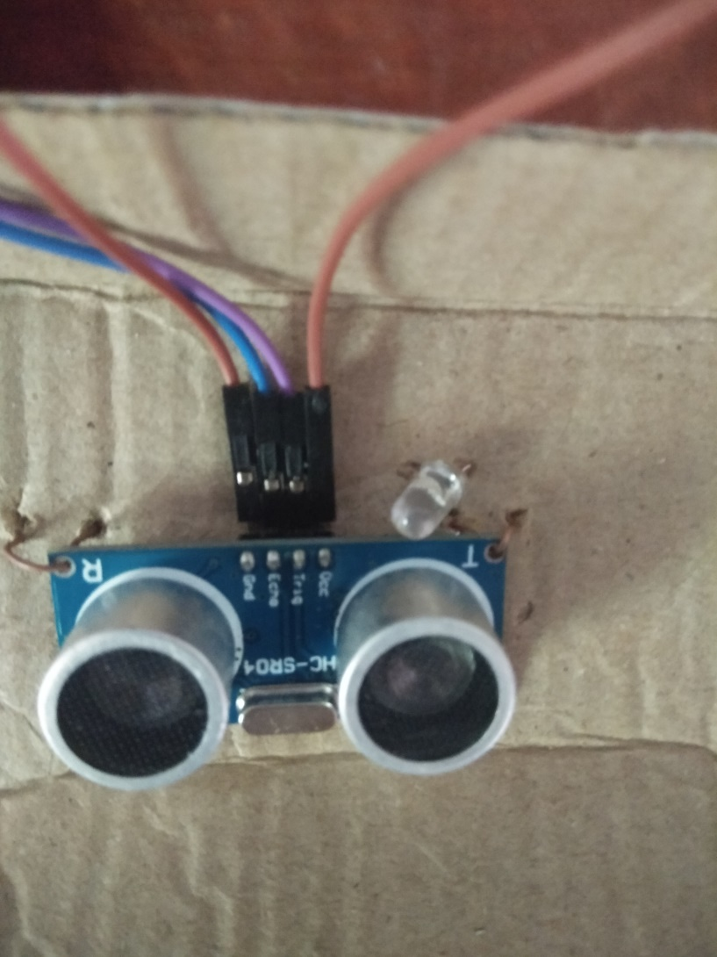
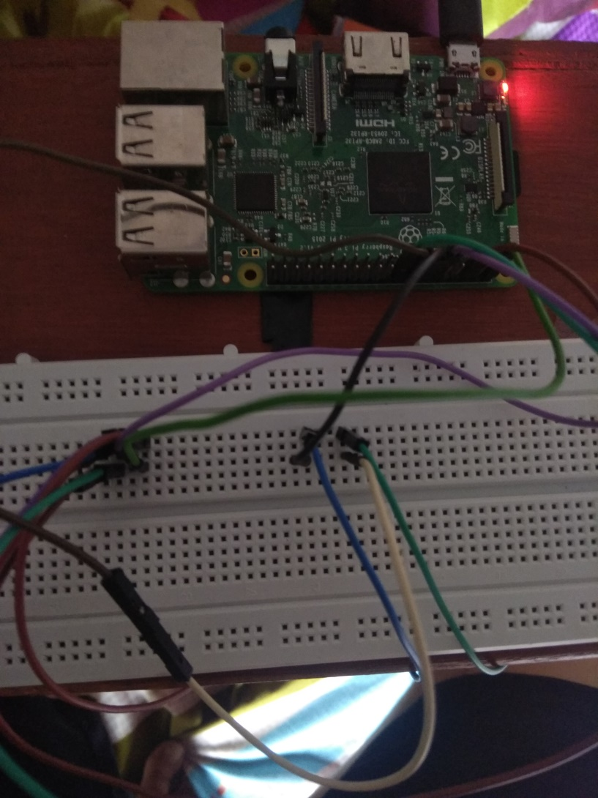
System Images

Slide 11
Demo
Demo of system is provided in link https://github.com/ritika2904/SMART-CLASSROOM/blob/master/demo.mp4

Slide 12
How it works
entrance
Entrance
4 m
4 m
Seat 1
Seat 3
U1
u3
Seat 2
Seat 4
u2
u4

Slide 13
BUSINESS MODEL
Install and manage an on-premise IoT platform with hardware.
Develop an app and web interface so that the management can know about the working of the system.

Slide 14
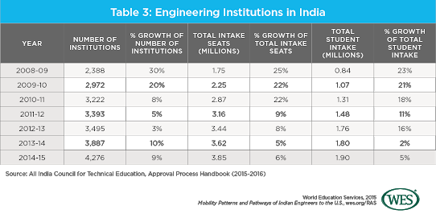
MARKET
If only Enginnering colleges are considered,
Then there are more than 4200 institutions as seen from the above data. Every institution have at least 20 classrooms which in total leads to 84000 classrooms.

Slide 15
Our Team
Shailender Pandey
Ritika Chauhan
Akash Agarwal

